Slide 1
THE BATTLE OF NEIGHBORHOOD
Breaking down Median House Prices and School Ratings for Scarborough

Slide 2
Description
Several people moving to multiple states of Canada require the output at extraordinary housing costs similarly to incredible rating schools for their children. The endeavours expect to make an examination of features for territory as a comparative assessment between neighbourhoods. The features join centre house cost and school assessments, bad behaviour rates, atmosphere conditions, recreational workplaces. This would assist people with getting the awareness of the spots before moving to another country, state, city or spot for their work or to start another life.
The purpose of this project is to assist people with researching various possible results and take an unrivalled decision on choosing the best neighbourhood from multiple zones in Scarborough city subject to the flow of various workplaces in and around that territory.

Slide 3
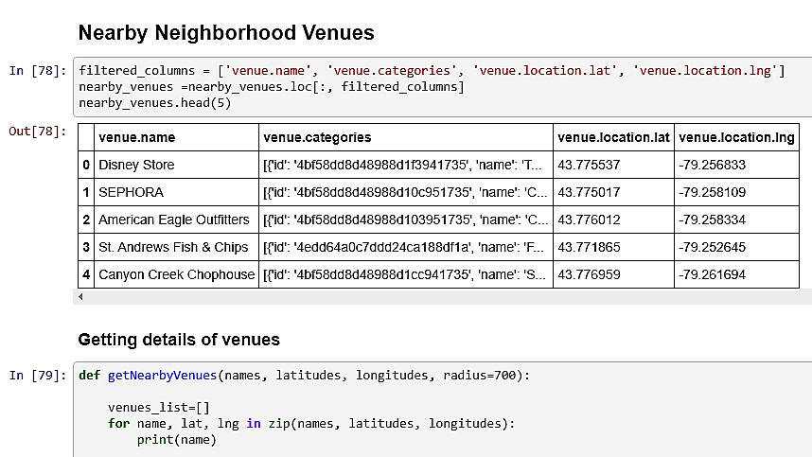
DATA REQUIRED
We will require geo-locational data about that particular district and the areas in that ward. It is "Scarborough" in Toronto.

Slide 4
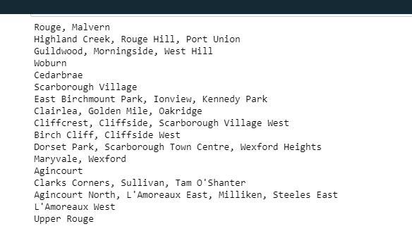
API
This venture would utilize Four-square API as its prime information gathering source as it has a database of a great many spots, particularly their places API which gives the capacity to perform area look, area sharing and insights regarding a business.

Slide 5
PROCESSING OF DATA
Handling the Retrieved Data and Creating a Data Frame for All the Venues inside the Scarborough.
At the point when the information is totally accumulated, we will perform handling on that crude information to locate our attractive highlights for every setting. Our principle include is the classification of that setting. After this stage, the segment "Scene's Category" will be One-hot encoded and diverse settings will have distinctive component segments.

Slide 6
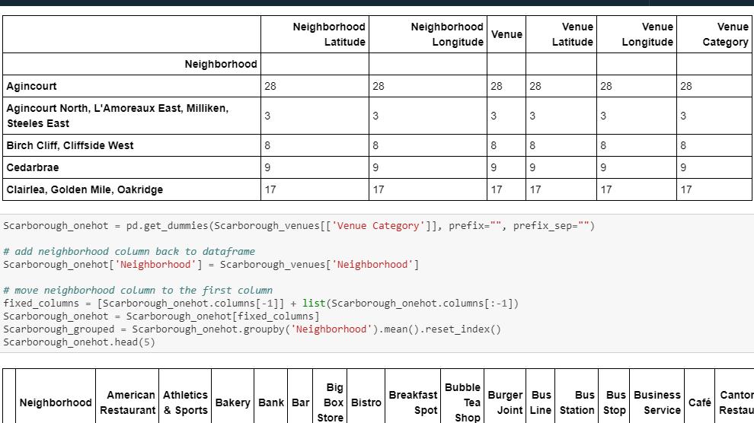
DATA FRAME CREATION

Slide 7
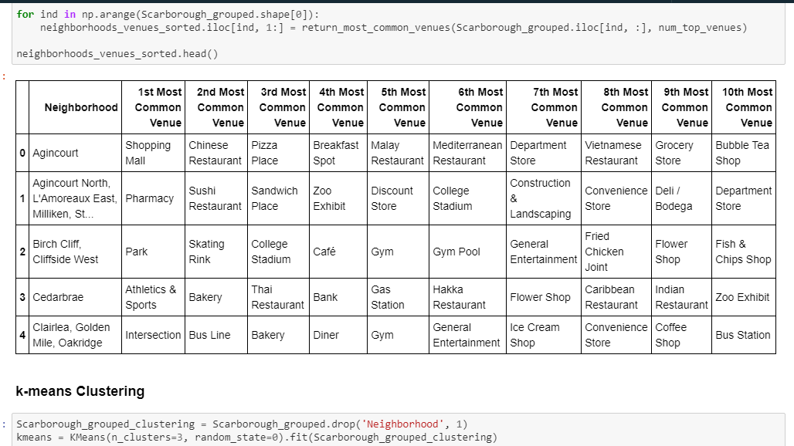
MOST COMMON VENUES

Slide 8
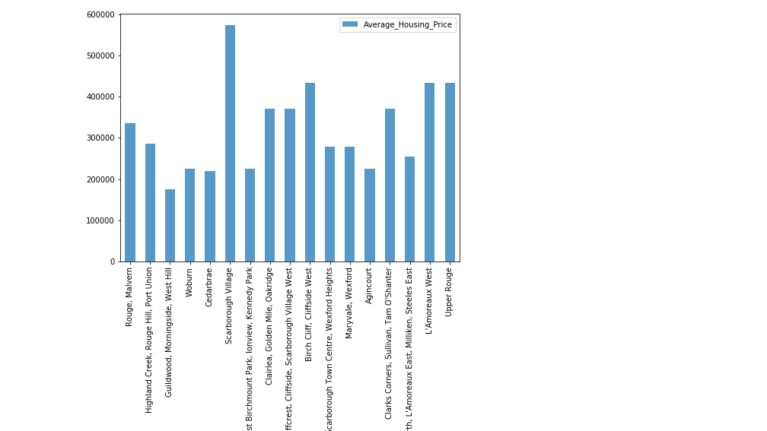
NEIGHBORHOOD HOUSING PRICES

Slide 9
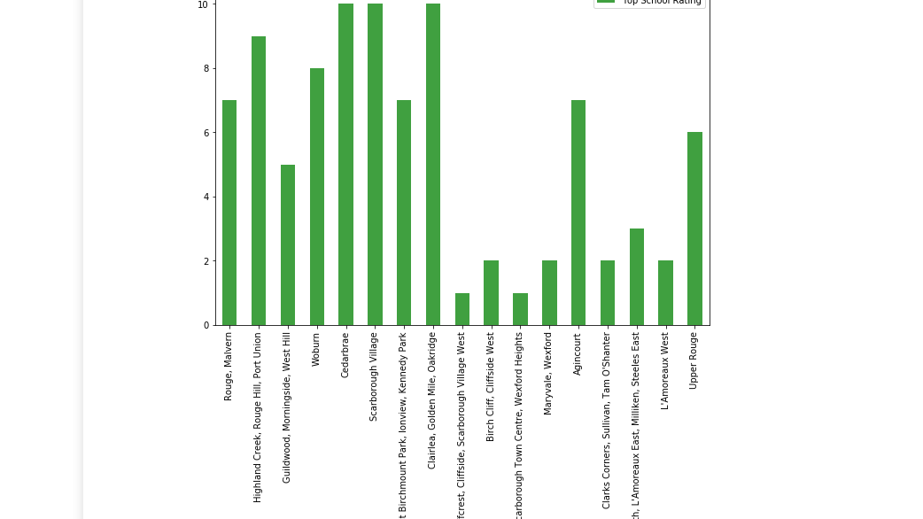
NEIGHBORHOOD SCHOOL RATINGS

Slide 10
Conclusion
In conclusion this task, through a k-means bunch calculation, we separate the area into 3 groups, which have comparable neighbourhoods around them. Utilizing the graphs above choice prompting a specific neighbourhood dependent overall house costs and school rating can be made.

